Slide 1
Ethics in Information Technology, Third and Fifth Edition
Computer and Internet Crime
Chapter 3
Notes:
1

Slide 2
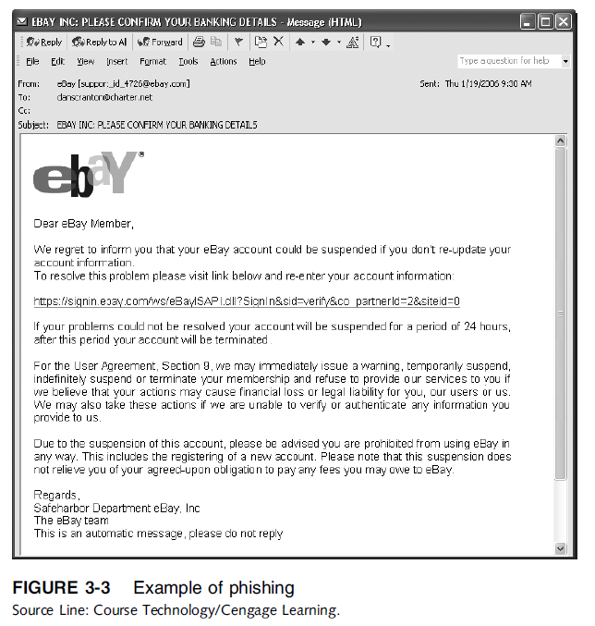
Ethics in Information Technology, Fourth Edition

Slide 3
Types of Perpetrators
Perpetrators include:
Thrill seekers wanting a challenge
Common criminals looking for financial gain
Industrial spies trying to gain an advantage
Terrorists seeking to cause destruction
Different objectives and access to varying resources
Willing to take different levels of risk to accomplish an objective
Ethics in Information Technology, Fourth Edition
Notes:
3

Slide 4
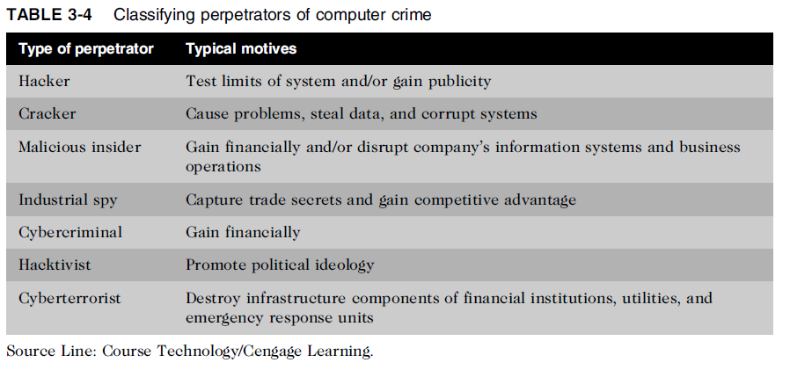
Types of Perpetrators (cont’d.)
Ethics in Information Technology, Fourth Edition
Notes:
4

Slide 5
Hackers and Crackers
Hackers
Test limitations of systems out of intellectual curiosity
Some smart and talented
Others inept; termed “lamers” or “script kiddies”
Crackers
Cracking is a form of hacking
Clearly criminal activity
Ethics in Information Technology, Fourth Edition
Notes:
5

Slide 6
Malicious Insiders
Major security concern for companies
Fraud within an organization is usually due to weaknesses in internal control procedures
Collusion
Cooperation between an employee and an outsider
Insiders are not necessarily employees
Can also be consultants and contractors
Extremely difficult to detect or stop
Authorized to access the very systems they abuse
Negligent insiders have potential to cause damage
Ethics in Information Technology, Fourth Edition
Notes:
6

Slide 7
Industrial Spies
Use illegal means to obtain trade secrets from competitors
Trade secrets are protected by the Economic Espionage Act of 1996
Competitive intelligence
Uses legal techniques
Gathers information available to the public
Industrial espionage
Uses illegal means
Obtains information not available to the public
Ethics in Information Technology, Fourth Edition
Notes:
7

Slide 8
Cybercriminals
Hack into corporate computers to steal
Engage in all forms of computer fraud
Chargebacks are disputed transactions
Loss of customer trust has more impact than fraud
Ethics in Information Technology, Fourth Edition
Notes:
8

Slide 9
Hacktivists and Cyberterrorists
Hacktivism
Hacking to achieve a political or social goal
Cyberterrorist
Attacks computers or networks in an attempt to intimidate or coerce a government in order to advance certain political or social objectives
Seeks to cause harm rather than gather information
Uses techniques that destroy or disrupt services
Ethics in Information Technology, Fourth Edition

Slide 10
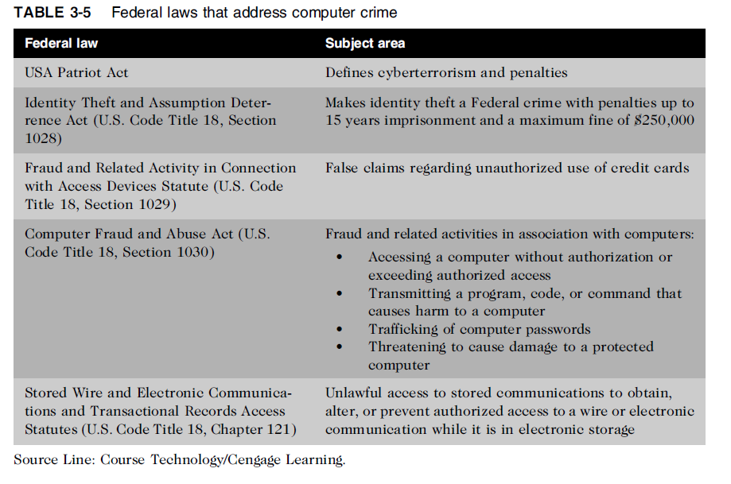
Federal Laws for Prosecuting Computer Attacks
Ethics in Information Technology, Fourth Edition

Slide 11
Summary
Ethical decisions in determining which information systems and data most need protection
Most common computer exploits
Viruses
Worms
Trojan horses
Distributed denial-of-service attacks
Rootkits
Spam
Phishing, spear-fishing, smishing, vishing
Ethics in Information Technology, Fourth Edition
Notes:
11

Slide 12
Summary (cont’d.)
Perpetrators include:
Hackers
Crackers
Malicious insider
Industrial spies
Cybercriminals
Hacktivist
Cyberterrorists
Ethics in Information Technology, Fourth Edition
Notes:
12

Slide 13
Summary (cont’d.)
Must implement multilayer process for managing security vulnerabilities, including:
Assessment of threats
Identifying actions to address vulnerabilities
User education
IT must lead the effort to implement:
Security policies and procedures
Hardware and software to prevent security breaches
Computer forensics is key to fighting computer crime in a court of law
Ethics in Information Technology, Fourth Edition
Notes:
13

